Slide 1
Functional Testing

Slide 2
What is Functional Testing?
Functional Testing is defined as a type of testing which verifies that each function of the software application operates in conformance with the requirement specification. This testing mainly involves black box testing and it is not concerned about the source code of the application.
Each and every functionality of the system is tested by providing appropriate input, verifying the output and comparing the actual results with the expected results.
This testing involves checking of User Interface, APIs, Database, security, client/ server applications and functionality of the Application Under Test. The testing can be done either manually or using automation

Slide 3
What do you test in Functional Testing?
The prime objective of Functional testing is checking the functionalities of the software system. It mainly concentrates on -
Mainline functions: Testing the main functions of an application
Basic Usability: It involves basic usability testing of the system. It checks whether a user can freely navigate through the screens without any difficulties.
Accessibility: Checks the accessibility of the system for the user
Error Conditions: Usage of testing techniques to check for error conditions. It checks whether suitable error messages are displayed.

Slide 4
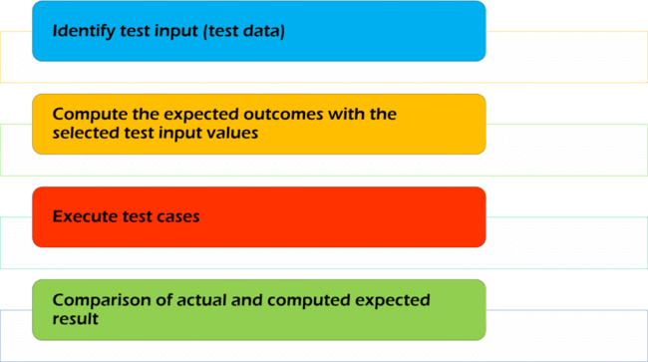
How to perform Functional Testing: Complete Process
In order to functionally test an application, the following steps must be observed.

Slide 5
Understand the Software Engineering Requirements
Identify test input (test data)
Compute the expected outcomes with the selected test input values
Execute test cases
Comparison of actual and computed expected result

Slide 6
Black Box Testing
Testing software against a specification of its external behavior without knowledge of internal implementation details
  Can be applied to software “units” (e.g., classes) or to entire programs
  External behavior is defined in API docs, Functional specs, Requirements specs, etc.
Derive sets of input conditions (test cases) that fully exercise the external functionality
Because black box testing purposely disregards the program's control structure, attention is focused primarily on the information domain (i.e., data that goes in, data that comes out)

Slide 7
Black Box Testing
Black box testing tends to find different kinds of errors than white box testing
  Missing functions
  Usability problems
  Performance problems
  Concurrency and timing errors
  Initialization and termination errors
  Etc.
Unlike white box testing, black box testing tends to be applied later in the development process
Black Box Testing Example #1

Slide 8
Equivalence Partitioning
Consider all of the possible values for a single input (i.e., the input's domain)
Frequently the domain is so large that you can't test all possible values
You have to select a relatively small number of values to actually test
Which values should you choose?
Equivalence partitioning helps answer this question

Slide 9
Equivalence Partitioning
Partition the input's domain into "equivalence classes"
Each equivalence class contains a set of "equivalent" values
Two values are considered to be equivalent if we expect the program to process them both in the same way
If you expect the program to process two values in the same way, only test one of them, thus reducing the number of test cases you have to run

Slide 10
What is Decision Table Testing?
Decision table testing is a software testing technique used to test system behavior for different input combinations. This is a systematic approach where the different input combinations and their corresponding system behavior (Output) are captured in a tabular form. That is why it is also called as a Cause-Effect table where Cause and effects are captured for better test coverage.
A Decision Table is a tabular representation of inputs versus rules/cases/test conditions. Let's learn with an example.

Slide 11
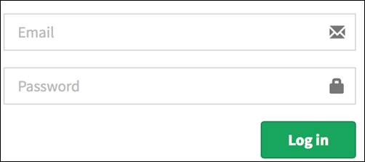
Example 1: How to make Decision Base Table for Login Screen
Let's create a decision table for a login screen.

Slide 12
The condition is simple if the user provides correct username
and password the user will be redirected to the homepage.
If any of the input is wrong, an error message will be displayed.
Legend:
T – Correct username/password
F – Wrong username/password
E – Error message is displayed
H – Home screen is displayed
Conditions | Rule 1 | Rule 2 | Rule 3 | Rule 4
Username (T/F) | F | T | F | T
Password (T/F) | F | F | T | T
Output (E/H) | E | E | E | H

Slide 13
Case 1 – Username and password both were wrong. The user is shown an error message.
Case 2 – Username was correct, but the password was wrong. The user is shown an error message.
Case 3 – Username was wrong, but the password was correct. The user is shown an error message.
Case 4 – Username and password both were correct, and the user navigated to homepage

Slide 14
Example 2: How to make Decision Table for Upload Screen
Now consider a dialogue box which will ask the user to upload photo with certain conditions like –
You can upload only '.jpg' format image
file size less than 32kb
resolution 137*177.
If any of the conditions fails the system will throw corresponding error message stating the issue and if all conditions are met photo will be updated successfully

Slide 15
Conditions | Case 1 | Case 2 | Case 3 | Case 4 | Case 5 | Case 6 | Case 7 | Case 8
Format | .jpg | .jpg | .jpg | .jpg | Not .jpg | Not .jpg | Not .jpg | Not .jpg
Size | Less than 32kb | Less than 32kb | >= 32kb | >= 32kb | Less than 32kb | Less than 32kb | >= 32kb | >= 32kb
resolution | 137*177 | Not 137*177 | 137*177 | Not 137*177 | 137*177 | Not 137*177 | 137*177 | Not 137*177
Output | Photo uploaded | Error message resolution mismatch | Error message size mismatch | Error message size and resolution mismatch | Error message for format mismatch | Error message format and resolution mismatch | Error message for format and size mismatch | Error message for format, size, and resolution mismatch

Slide 16
Error Guessing
Tester guesses from his /her experience on the error-prone area and concentrates around that area.
Example : When the bike stops, first thing you do is – check the petrol.
You probably wont
go to mechanic or
read the manual or
check the spark plug
You know from your experience or
usage that petrol could be over.

Slide 17
Comparison Testing
Also called Back-to-Back testing
If you have multiple implementations of the same functionality, you can run test inputs through both implementations, and compare the results for equality
Why would you have access to multiple implementations?
  Safety-critical systems sometimes use multiple, independent implementations of critical modules to ensure the accuracy of results
  You might use a competitor's product, or an earlier version of your own, as the second implementation
  You might write a software simulation of a new chip that serves as the specification to the hardware designers. After building the chip, you could compare the results computed by the chip hardware with the results computed by the software simulator
Inputs may be randomly generated or designed manually
Notes:
EX: Nvidia graphics chips specified with software simulation. Real chip compared back-to-back with simulation to verify implementation.
EX: Database drivers
EX: Web Crawler in 240

Slide 18
Random Testing
Randomly generate test inputs
  Could be based on some statistical model
How do you tell if the test case succeeded?
  Where do the expected results come from?
Expected results could be calculated manually
  Possible, but lots of work
Sometimes the expected result can be trivially defined
  Send random sequences of commands to a device and see if you can crash it
    Expected result: It shouldn't crash
  Use load simulation software to simulate many clients accessing a multi-user system
    Measure the average wait time for clients
    Expected result: Average client wait time should be within the bounds set by the requirements specification

Slide 19
Thank you

